Slide 1
Use complex techniques to develop a digital media outcome your name Cameron Jefferies

Slide 2
Step 1 : Empathize

Slide 3
Task 1 : Identify your client and the purpose of your website, who is your target audience?
My client is Jesse Scott personal training. Jesse is a personal trainer who has many clients and is based in Dunedin he works for himself and lesmils gym. The purpose of my website is to develop a website that is aesthetically pleasing and easy to use as he has only got a Facebook page. My target audience is going to be people young people from around 14 all the way up to older people probably in the 60-70.

Slide 4
Relevant Implication #1 Copy right
I am going to be focusing on Copy right as I do not want to break and copy right laws all the photos and videos, I have got i have permission to use from Jesse these photos and videos are from his Facebook page. If I decide to get and other photos from any where I will have to make sure that I have permission to use them or they are labeled for reuse.
Notes:
Identify and explain 3 relevant implications that you will focus on during the creation of your project

Slide 5
Relevant Implication #2 Usability
I will make my web page very easy to use by adding in hover tags where they are needed as it make it easier for the user to get where they want to get I will also add in footer so the user doesn’t have to do unnecessary scrolling back to the top of the page
I will have to make sure that I make the website is able to be used on tablets and phones as not everyone has a computer and they will use their phone or tablet instead. I will do this by using media queries so it will scale to the device they using
Notes:
Identify and explain 3 relevant implications that you will focus on during the creation of your project

Slide 6
Relevant Implication #3 Aesthetics
I want my website to be aesthetically pleasing to people, I will make my website pleasing to people by using fonts that work together and colours also, I will also follow a modern trend with my website the trend is a nice modern and sleek website what are promoting the same product or service I am. I will make sure the font is also easy to read as it people would have a smoother time on the website instead of trying to read a font what is hard to read.
Notes:
Identify and explain 3 relevant implications that you will focus on during the creation of your project

Slide 7
What are your client’s specifications?
The website need to be scalable for all devices as not everyone has a desktop or laptop
The website needs to have 4 linked pages Home page, book a workout page, about page and a quick tips page
sophisticated digital effects (CSS3)
responsive design (mobile vs tablet vs desktop)
industry standards or guidelines for layout/design
integration of original media types (your own photographs/ videos etc)
coded using HTML5/CSS3 language
4 html pages and with an externally linked style sheet / js file for responsive navigation

Slide 8
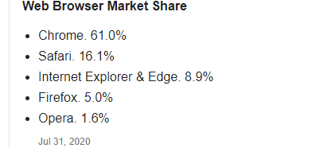
Current browser trends
I am going to make my web page for chrome as that is the most used browser by far

Slide 9
Step 2 : Define

Slide 10
Website Structure
Website Site Map
index.html
Contact.html
Book a workout.html
about.html

Slide 11
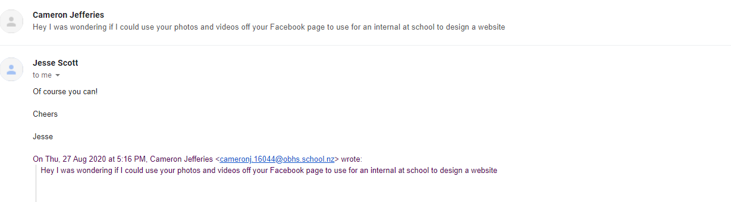
Evidence of written permission

Slide 12
Data Integrity Gather content – proofread and edit
Notes:
Data integrity is ensuring the information displayed is up to date , spelled correctly . Do F7 on your word content.
Testing

Slide 13
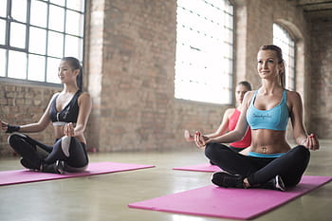
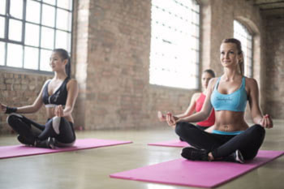
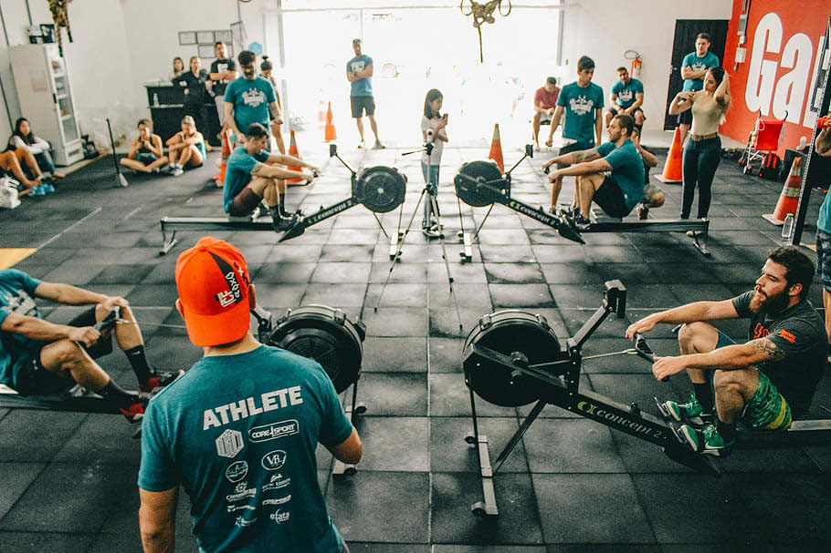

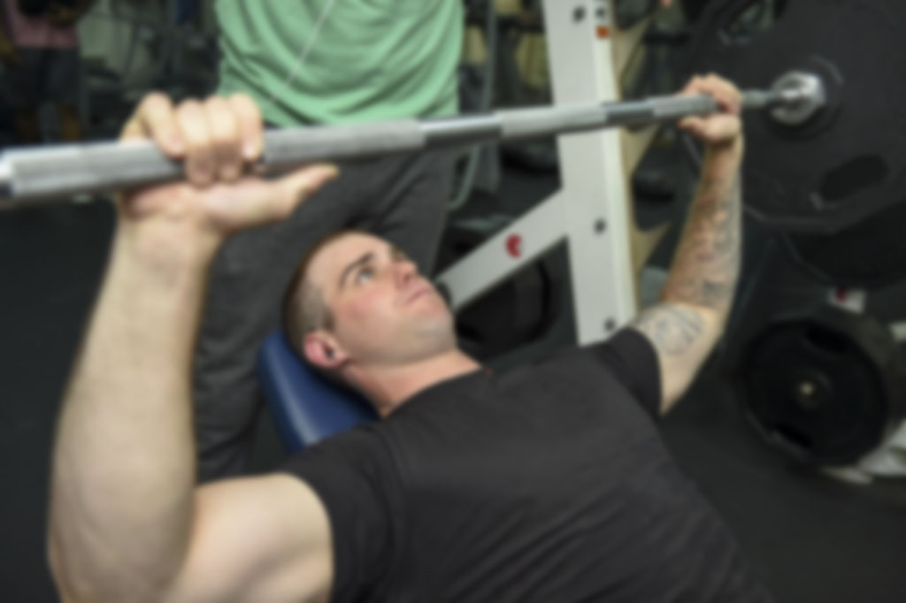
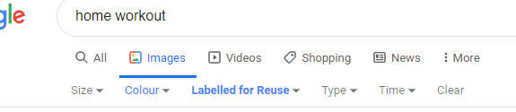
Gather Content
I have added a gaussian blur to make pictures what are going to be on my work out page
Notes:
Save images to an appropriate name folder
Compress / edit images where need be
Name the files accurately e.g home_mainimage.jpeg suzanne_collins_closeup.jpeg rather than 249784sflkjfnjksfxn3r8.jpeg
Record this process

Slide 14
Step 3 : Ideate

Slide 15
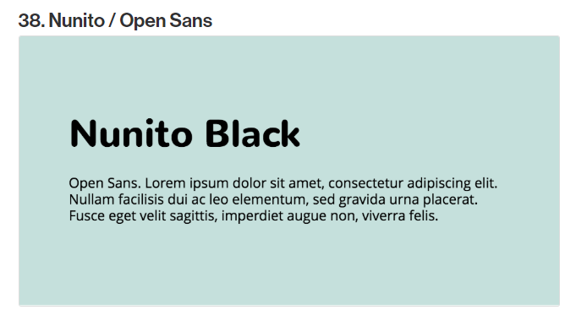
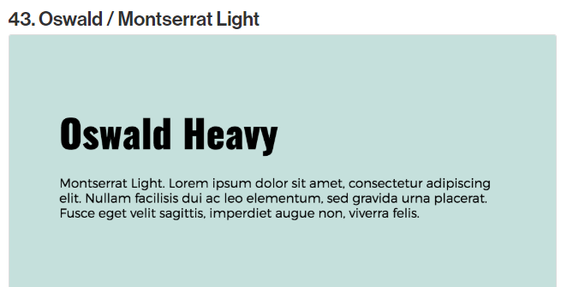
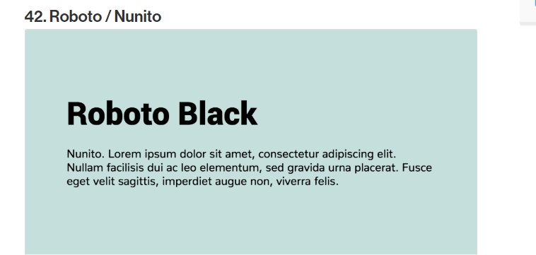
Font Combinations
Vote 111
Vote 11111
Vote 111

Slide 16
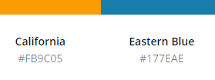

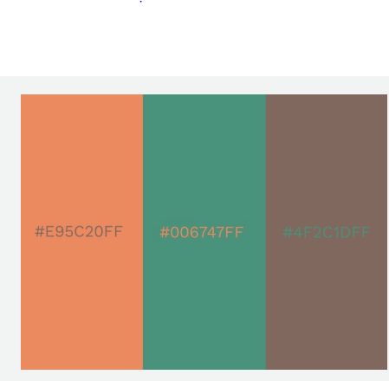
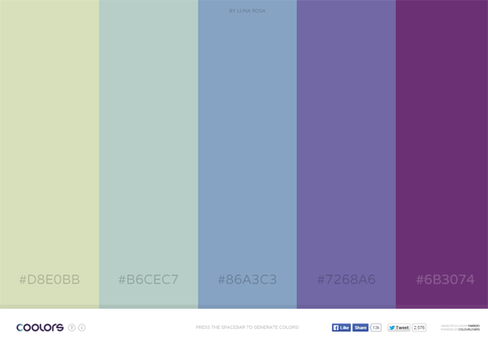
Colour combinations
These colours are from his logo
Vote 111111
Vote 1
111
Vote
1111

Slide 17
Fonts and Colours feed back

Slide 18
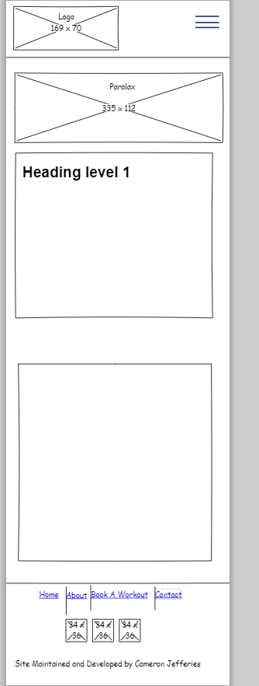
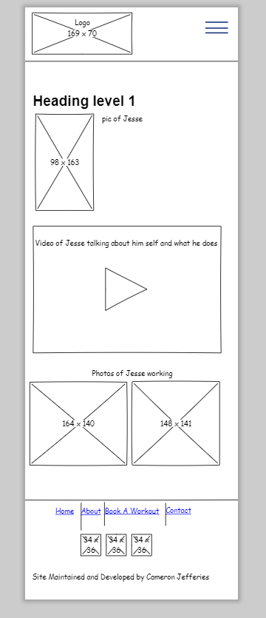
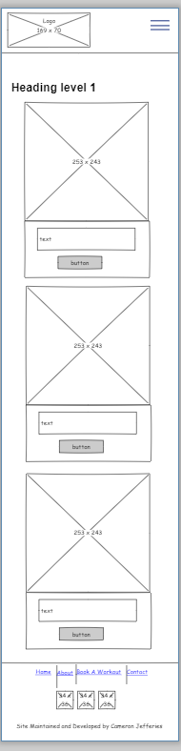
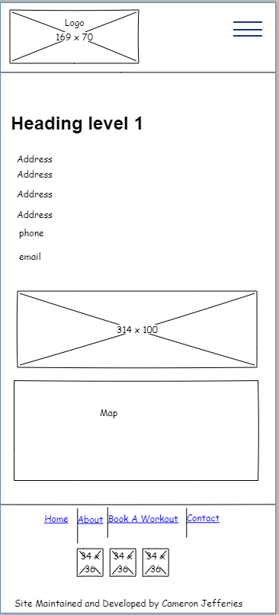
Low fidelity wireframes
Notes:
Use either

Slide 19
A vs B testing - colours
Notes:
Give two layout options for the index page – eg placement of cotent . Get feedback from client

Slide 20
A vs B testing - fonts
Notes:
Give two layout options for the index page – eg placement of cotent . Get feedback from client

Slide 21
Feedback from client / stakeholders
Notes:
Get written feedback, then add your own reflections:
What changes do you need to make and why? Do you need to carry out further research or give more colour/font options etc/

Slide 22
Step 4 : Protype/ Testing

Slide 23
Site setup

Slide 24
Evidence of iterative improvement

Slide 25
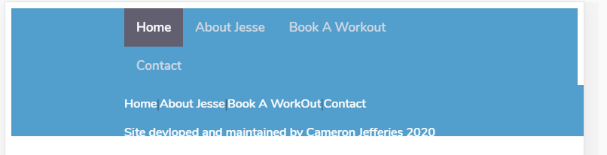
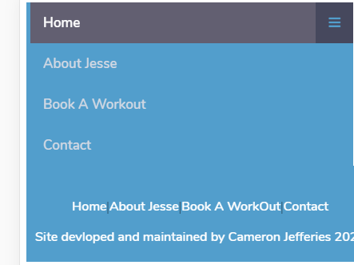
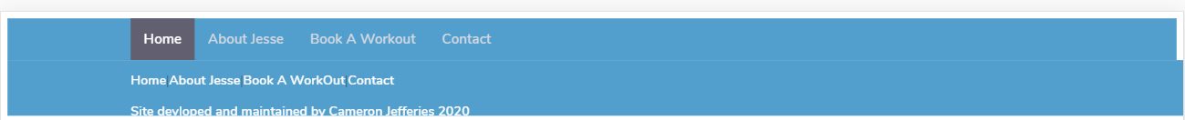
Testing Scaling: Phone vs Tablet vs Desktop
s
Notes:
Test your site on mobile, tablet and pc view

Slide 26
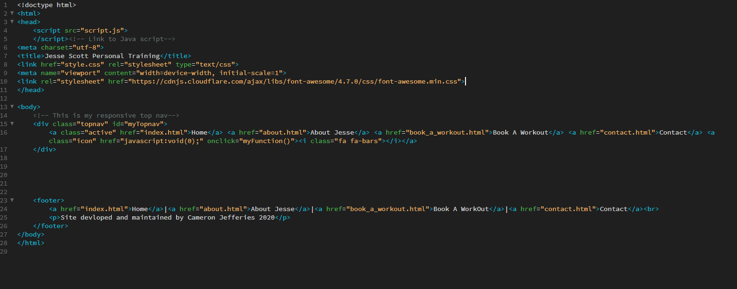
Day 1

Slide 27
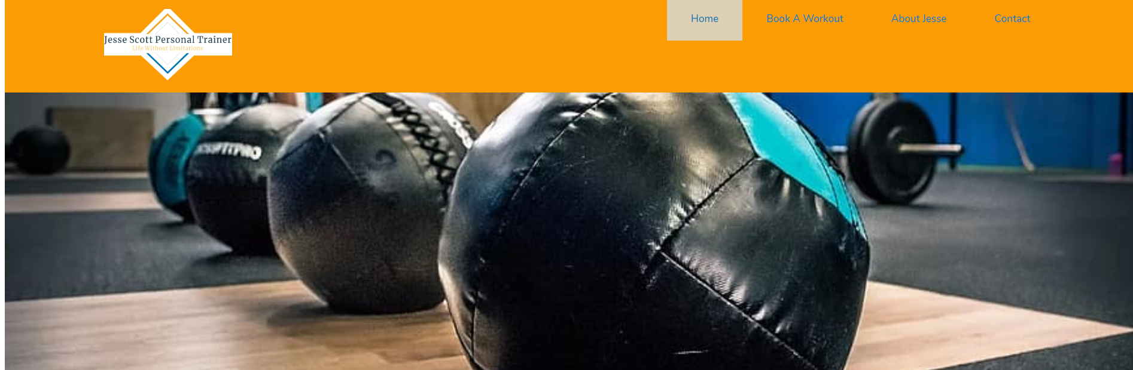
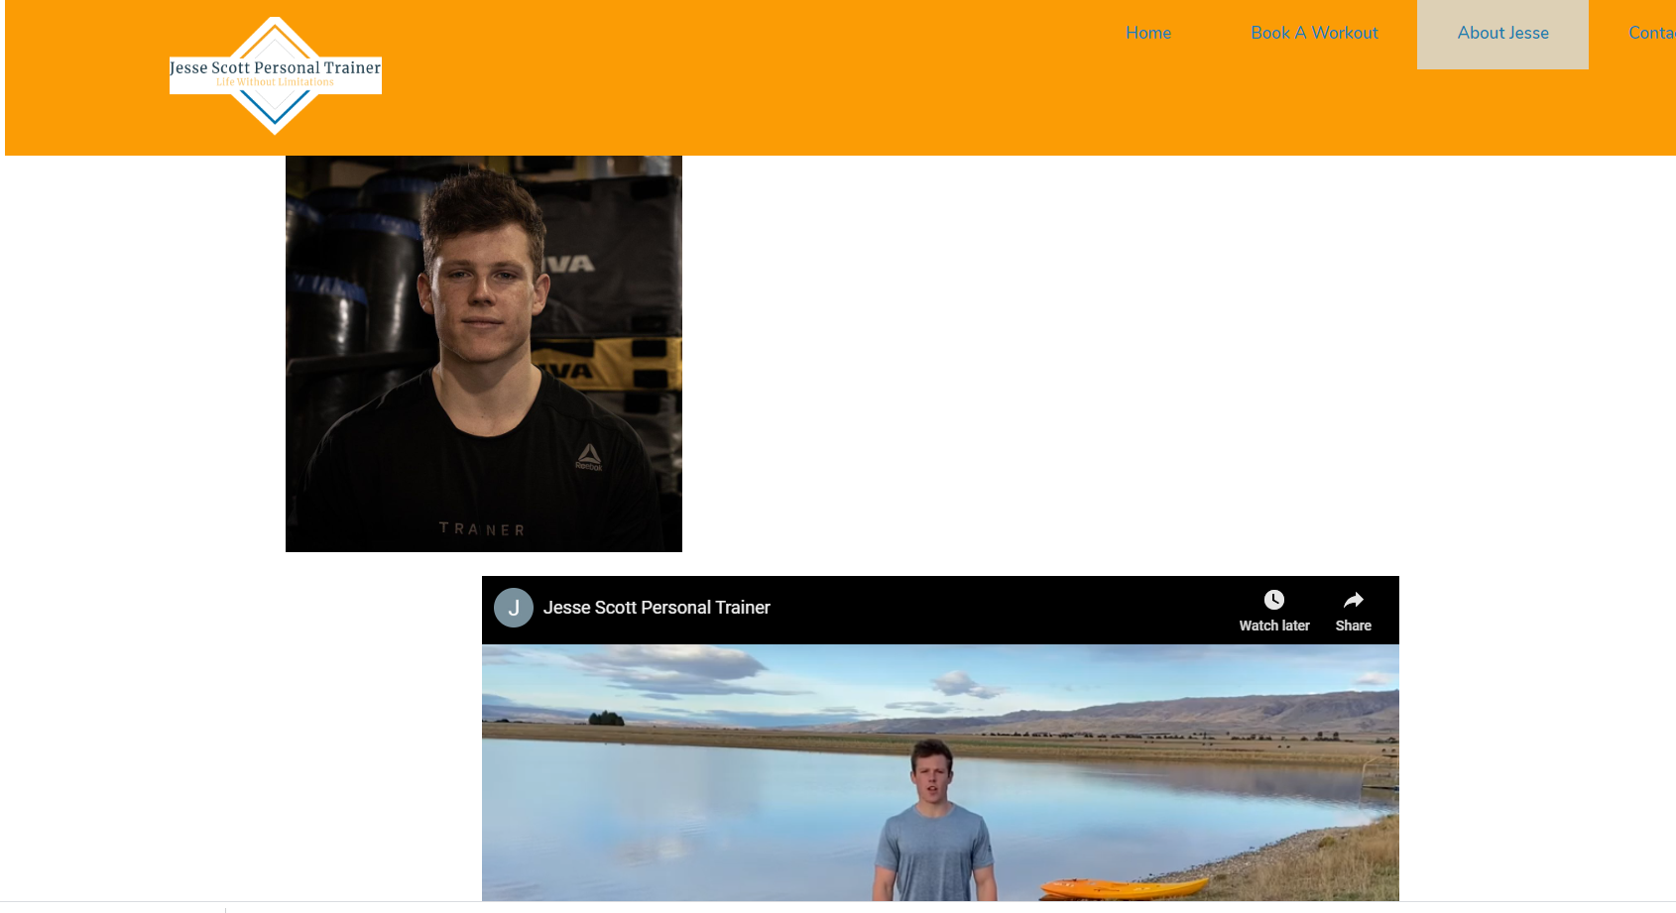
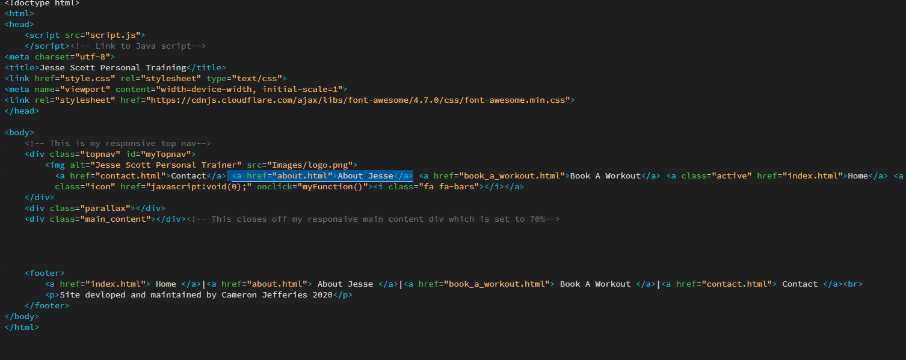
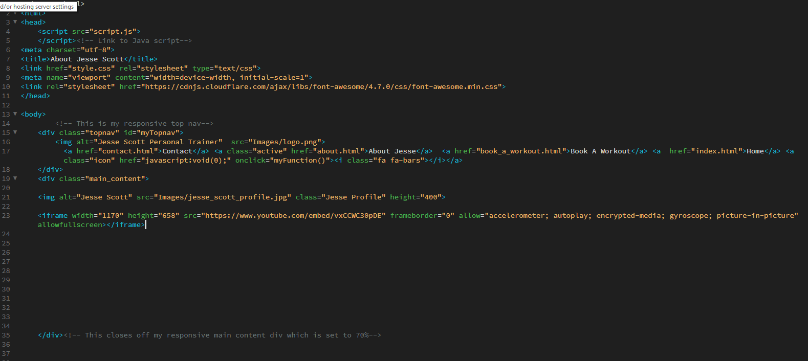
Days 2

Slide 28
Testing Procedures: Validating the HTML/CSS
Notes:
Validate your HTML/CSS3 website – screenshot the no errors.

Slide 29
Applying the UX (BASIC priniciples)to improve your design
Notes:
Identify which usability principles you have applied to improve the quality of your design – screenshot your design, place in your portfolio and annotate and explain how it improved the usability, aesthetics or functionality etc.

Slide 30
Explain how your final design addressed the relevant implications

Slide 31
Addressing relevant implication :

Slide 32
Addressing relevant implication :

Slide 33
Final website
Notes:
Create a video of your site in desktop view, slowly going through the content, scale it down to phone view too,. Insert the video above

Slide 34
Final feedback from client

